Slide 1
Electronics Sales Analysis
Sep 2023 – 2024
Comprehensive Dashboard Insights
Dataset Source: Kaggle | Tool: Microsoft Power BI
Revenue Analysis
Customer Behavior
Product Insights
Payment Trends
Presented by: Electronics Data Analysis Team

Slide 2
Table of Contents
What We'll Cover Today
Problem Statement
Top 5 Insights
01
05
What challenges this analysis addresses
Critical findings from the data
Project Overview
Payment & Shipping Analysis
02
06
Dataset scope, tools & methodology
Customer preference trends
Key Metrics Dashboard
Add-on & Rating Analysis
03
07
Revenue, orders, ratings at a glance
Revenue impact & customer satisfaction
Product Performance
Future Enhancements
04
08
Category-wise revenue & top products
Recommendations & next steps

Slide 3
Problem Statement
Why This Analysis Matters
Business Challenge
Analysis Goals
1
Lack of visibility into which product categories drive the most revenue
✓ Identify top revenue-generating product categories
2
Unclear understanding of customer payment preferences and friction points
✓ Understand customer payment preferences
3
Insufficient insight into how shipping methods affect purchasing decisions
✓ Analyze shipping method distributions
✓ Measure add-on purchase contribution
4
No consolidated view of add-on purchase impact on total order value
✓ Evaluate customer satisfaction levels
5
Absence of actionable customer satisfaction metrics from ratings data
✓ Provide data-driven business recommendations

Slide 4
Project Overview
Dataset, Tools & Methodology
Dataset Source
Dataset Columns
Kaggle – Electronics Sales Dataset
▸ Order ID
Time Period
September 2023 – September 2024 (13 Months)
▸ Product Category
▸ SKU / Product Name
Visualization Tool
▸ Unit Price
Microsoft Power BI Desktop
▸ Quantity Ordered
Total Records
▸ Total Revenue
~20,000+ Transaction Records
▸ Payment Method
Analysis Type
▸ Shipping Type
Exploratory Data Analysis (EDA) & Dashboard
▸ Add-on Purchase
▸ Customer Rating

Slide 5
Key Metrics Dashboard
At-a-Glance Performance Summary
$2.82M+
20,000+
5
Total Revenue Generated
Total Orders Processed
Major Product Categories
4.2 / 5
3
3
Avg. Customer Rating
Payment Methods Tracked
Shipping Types Available
Revenue Contribution by Category

Slide 6
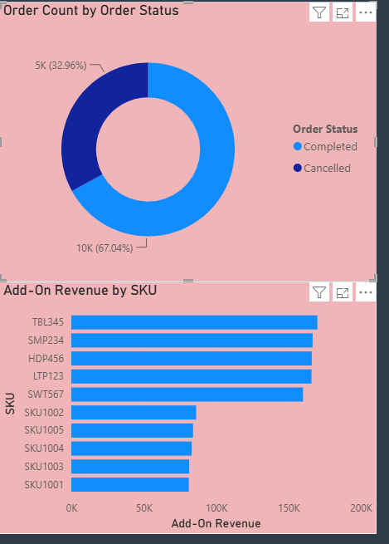
Product Performance Analysis
Category Revenue & Order Distribution
Units Sold by Category

Slide 7
Top 5 Key Insights
Critical Findings from the Data Analysis
Smartphones Generate the Highest Revenue
1
Smartphones account for ~29% of total revenue, making them the single most valuable product category, driven by high unit prices and consistent demand throughout the year.
Digital Payment Methods Are Most Preferred
2
Digital wallets and online transfers dominate transactions, indicating strong customer preference for cashless, contactless payment — a key area for optimizing checkout flow.
Express and Standard Shipping Are the Most Used
3
The majority of customers opt for Express or Standard shipping. Same-day delivery accounts for a smaller but growing share, suggesting opportunity to expand fast delivery options.
Add-on Purchases Increase Overall Revenue
4
Orders with add-on items (accessories, warranties, bundles) generate significantly higher average order values, making upselling a high-ROI strategy for revenue growth.
Customer Ratings Are Generally Positive
5
Average customer rating of 4.2/5 reflects overall satisfaction. Higher-rated products correlate with repeat purchases and fewer returns, validating product quality investments.

Slide 8
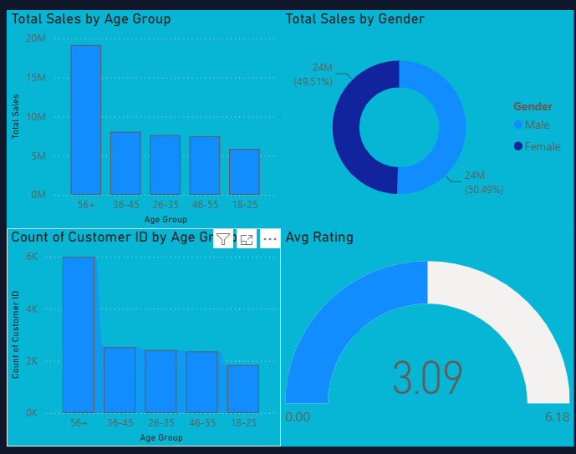
Customer insights
Customer Preference Trends

Slide 9
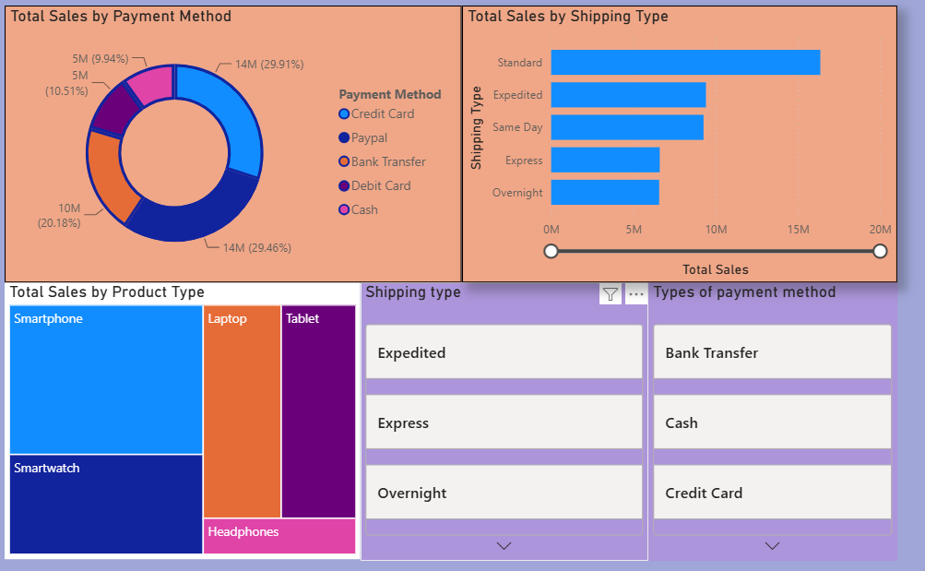
Product & Operations Analysis
Revenue Impact & Satisfaction Metrics

Slide 10
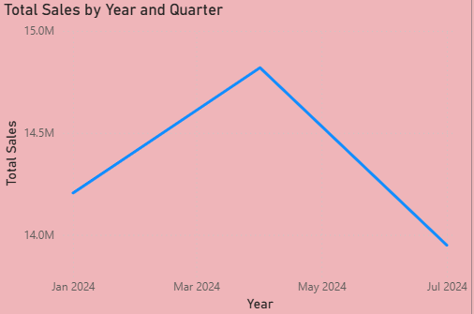
Year Revenue Trend
Sep 2023 – Sep 2024 Performance
Peak: Dec 2023 (+54% vs Sep) & Sep 2024 — Holiday Season & Annual Cycle

Slide 11
Future Enhancements
Recommendations & Next Steps
01
Predictive Revenue Forecasting
02
Customer Segmentation Analysis
Implement ML-based forecasting models to predict next quarter's revenue by category, enabling proactive inventory and marketing planning.
Cluster customers by purchase behavior, payment preference, and product affinity to enable targeted promotions and personalized recommendations.
03
Real-Time Power BI Dashboard
04
Regional Sales Breakdown
Connect the dashboard to live data sources for real-time monitoring of sales KPIs, enabling faster business decisions.
Add geographic dimension to identify high-performing regions, underserved markets, and location-based shipping optimization opportunities.
05
Return & Refund Analysis
06
Competitor Benchmarking
Incorporate returns and refund data to identify problem products, improve quality control, and reduce post-sale costs.
Integrate external market data to benchmark pricing, product mix, and customer satisfaction against industry peers.

Slide 12
Conclusion
This Electronics Sales Analysis dashboard (Sep 2023–2024) reveals clear patterns: Smartphones dominate revenue, digital payments are the preferred transaction method, and add-on purchases are a significant revenue multiplier. Customer satisfaction, measured at 4.2/5, validates overall product quality. These insights empower stakeholders to make data-driven decisions in inventory management, marketing strategy, and customer experience enhancement.
Smartphones:
#1 Revenue Driver (29% share)
Digital Payment:
Most preferred by customers
Add-on Purchases:
Up to 88% higher order value
Customer Rating:
Avg 4.2 / 5.0 – Positive
Thank You | Electronics Sales Analysis | Sep 2023–2024

